Slide 1
Group 5:
Vision-based Navigation of a Mobile Robot.

Slide 2
Machio Festus Brian E022-01-1070/2018
Janet Chepkirui E022-01-1753/2017
Mathenge King’au E022-01-1838/2018
Fred Mutegi E022-01-1054/2018
Brian Gacheru E022-01-1060/2018

Slide 3
ABSTRACT
Autonomous cars are robot vehicles designed to navigate with minimal human intervention. This is achieved using sensors to perceive the environment, and they have been extensively studied as one of the top technologies for the
future. This paper describes the development of a complete autonomous robot car, that seeks to address this challenge using a camera as the main input.
The results found suggest that the robot car can be a simple representation of modern autonomous cars like Tesla, though more work is needed integrating the systems with one another for a correct functioning of the car.

Slide 4
Problem Statement
From the previous year project,Intelligent Navigation of a Ground Vehicle, we seek to improve the robots functionality by incorporating Vision. The inclusion of a camera module greatly improves its Perception functionality. This with the help of other sensors and feedback such as the Inertial Measurement unit and encoders, by sensor fusion ensures the kind of data processed for navigation is applicable in a real world environment and in diverse scenarios.

Slide 5
OBJECTIVES
Main Objectives.
To design a mobile robot that incorporates vision to track and keep a designated lane, navigate to evade obstacles and, track to follow a blob.
Specific Objectives.
• To come up with a 3D model of the mobile robot.
• To design the electrical schematic of the mobile robot.
• To program and simulate the mobile robot control.
Next Semester Objective.
•Assembling, testing and demonstrating the navigation capability of the robot.

Slide 6
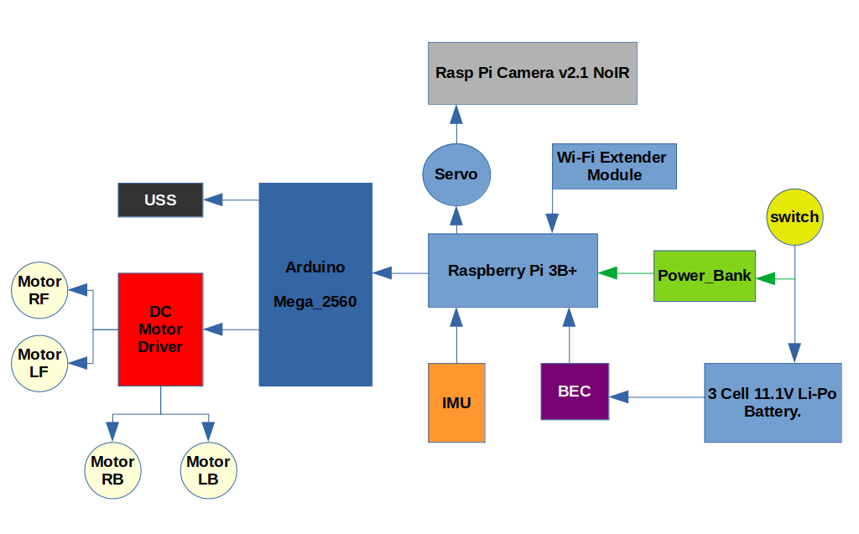
Electrical Components
and Connection.

Slide 7
Control : Motion & Event
/home/braen/Desktop/Prep_presentation.docx
1. Motion – Tele-operation and Navigation
2. Event / Behavior – Obstacle Avoidance and Lane Detection
/home/braen/Desktop/Presentation_1.odg

Slide 8
Motion: Transforms
Camera mounted on the chassis detects an Object of Interest, therefore the chassis has to coordinate its motion – wheel rotation towards or away from the object.
Position-based visual Servoing.
/home/braen/Desktop/Presentation_1.odg

Slide 9
Transform Library: /tf
Using the ROS transform library has these advantages:
Frames are defined with respect to one another in a tree form. This means that when one frame undergoes a transformation its noted by the other frame attached to it. A frame whether Static or Dynamic, its easily defined.
/home/braen/catkin_ws/src/diff_drive/urdf/Diff_Drive.pdf

Slide 10
Robot Brain: Control
/home/braen/Desktop/Presentation_1.odg

Slide 11
References
1. TurtleBot3 Developers, (2017) YoonSeok Pyo I HanCheol Cho I RyuWoon Jung I TaeHoon Lim, ROBOTIS Co. Ltd.
2. Shigley, J. E. (2011). Shigley's mechanical engineering design. Tata McGraw-Hill Education.
3.Richardson, M., & Wallace, S. (2012). Getting started with raspberry PI. " O'Reilly Media, Inc.".
4. Kurkovsky, S., & Williams, C. (2017, June). Raspberry Pi as a platform for the Internet of things projects: Experiences and lessons. In Proceedings of the 2017 ACM Conference on Innovation and Technology in Computer Science Education (pp. 64-69).

Slide 12
Budget
/home/braen/Desktop/Docs/Final Year/1st Semester/Project/Vision AGV/Group 5: Vision Based Navigation.pdf

